Slide 1
HUMAN RIGHTS ANIMAL RIGHTS ENVIRONMENTAL RIGHTS

Slide 2
THE SOCIAL MISSION
… FOR LONG TERM

Slide 3
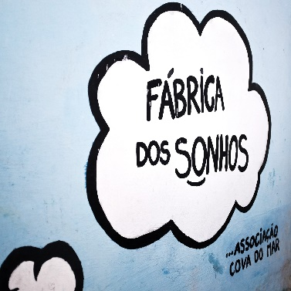
R.I.C.O.
2015/2016
NGO’s Foundation
2016
Open Holiday
Camp (with IPDJ license)
2016/2017
Factory of Dreams
2017
Dog Rescue and
Intervention
And others
20.. ?
Dreams’ chest
(elder people)
20.. ?
Adventure Barracks
(Closed Holiday Camp)
20.. ?
Porto Mar
Cabo Verde
(NGDO)

Slide 4
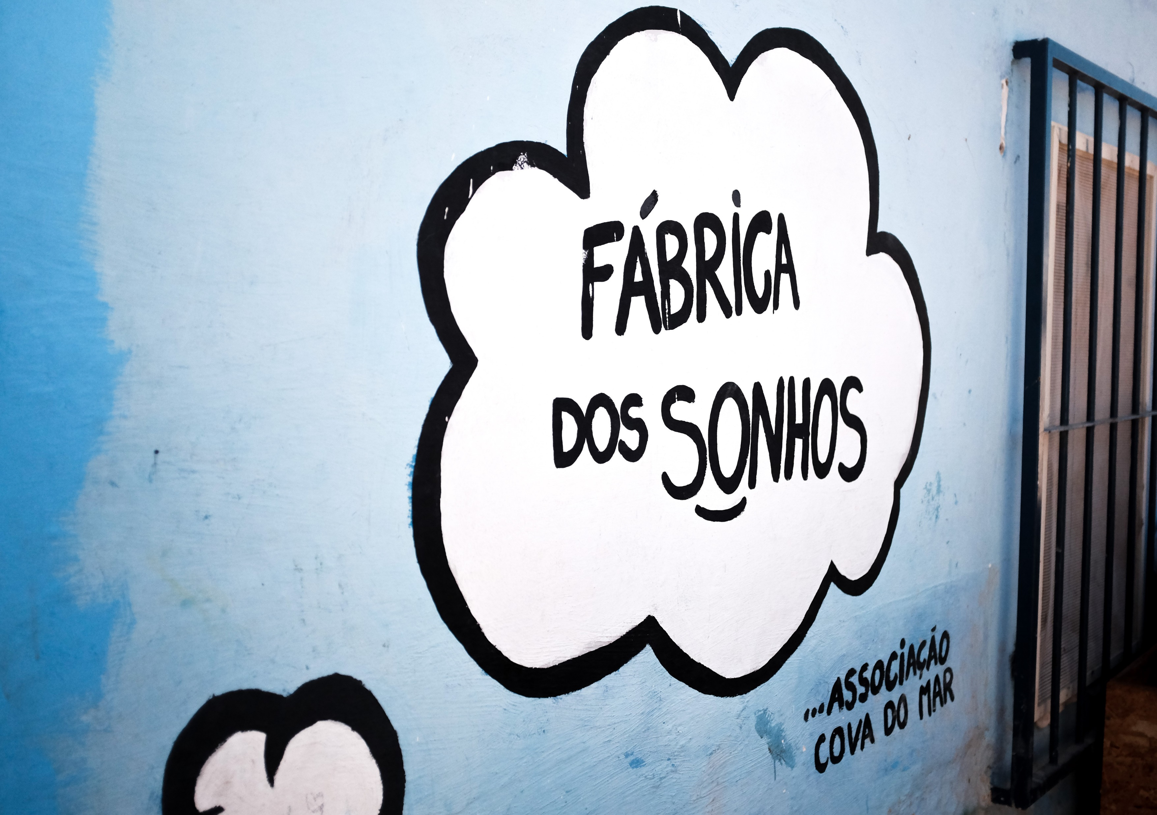

Slide 5
THE FACTORY OF DREAMS
… BY THE TESTIMONY OF SOME VOLUNTEERS

Slide 6
“The first contact that I had with 2nd Torrão neighborhood, an illegal neighborhood where around 200 children live, was in 2016 and it was consequently, my first contact with Cova do Mar Association.
In first place, it is important to refer that it is a neighborhood with precarious houses built next to the sea and surrounded by a wall all around. It’s a difficult access neighborhood where the residents occupy the houses without legal security, sometimes without access to natural resources like light, energy to cook, heating, means to preserve foods (among others), in other words, without the UN’s defended conditions of habitability has a fundamental right.
Apart from the housing issue, it matters to know that in this neighborhood people from many nationalities live in that, in general, have more difficulties to be part of the labor market and consequently many of them do not have enough income to satisfy their basic needs and the ones from their families.
All the factors above described put these families in situations of social exclusion and stand aside of the society and has a consequence this population become tagged by stigmatization on the part of society where they are included by they don’t feel they belong.
This social exclusion affect, in particular the children in the creation interpersonal relationships outside the neighborhood context that perpetuates the segregation and that is where the Cova do Mar Association enters and the project Factory of Dreams.
According to what I saw and lived as a volunteer of this Association, its main big goal is to grant the children that attend it with emotional and social skills that allows them to become stable and responsible adults.
At Factory of Dreams the focus is the children, they are always at the center of the action. There they can share their opinions without judgement; they are given several responsibilities of leadership for them to acquire tools for the future, they can argument and take their own decisions and they learn that all their actions have consequences. This ability to endow the children, not only demonstrates the potential of its own Association as guarantees its continuity in the territory. These children will never forget of the importance that this place had for them and they will take with them these teachings for the lives they chose to have and, thanks to the Factory of Dreams they know they can be whatever they wish to be and that they can change the world.”
Mariana Brigham da Silva
Social Assistant | Member, Volunteer and Vice-President of the Audit Committee (2019/2021) of Cova do Mar’s Association

Slide 7
“My name is Leonor Brito Esteves and I’m an Psychiatric Intern Doctor at Egas Moniz Hospital in Lisbon. I met in 2017 the Cova do Mar Association and since then I’m a volunteer in this project.
This association provides support to the population of 2nd Torrão neighborhood, an illegal neighborhood where around 1500 people live, of which 200 of them are children. These people live in conditions of extreme poverty, no access to basic sanitation, legal electric light, in approximately 500 tents. The 2nd Torrão neighborhood locates at Trafaria, Almada’s County. Right by the cereals’ silos, that are so easily seen from Lisbon, live people where their human rights are violated daily.
One of the big projects of Cova do Mar Association is the 'Factory of Dreams' (FS), born in December 2016. The Factory of Dreams has as a goal to provide to these children a place of refuge that gives support to the study, to the playful-pedagogical activities, to the development as individual and to the development as a group. Focused in providing support to these children from 6 to 17 years old, the FS provides to the children a free place where they can hang out after classes, to play and study in safety. For those who have more difficulties at school there is also stimulated tutoring for the most complicated subjects.
Besides this, there is a whole set of activities that promote the self-confidence, the personal development, the self-determination capacity and the discovery of other realities and experiences, like for instance karate classes, surf and something as simple as like going to the cinema. These activities not only happen during school year but also during their vacation.
Thanks to the Cova do Mar these children spend less time in the street, they are loved and protected, and they have a place where the childhood is given to them that they didn’t know before they entered at FS.”
Leonor Brito Esteves
Psychiatric Intern Doctor | Member and Volunteer of Cova do Mar Association

Slide 8
“All that it can be said about the project Factory of Dreams cannot be decoupled from the location where it is inserted, the 2nd Torrão neighborhood. We can dissert about the injustice of the social inequality, about the innocent children victimization, because many of them are in fact, or about the resilience facing the existence, in full XXI century, of neighborhoods like this one.
It’s, also, for all this that the “Factory” is there, but its work goes beyond that.
The nobility of associations like Cova do Mar is immeasurable. Not having proper funds and depending on volunteers and charitable it is a hard task. About the principle that “all children deserve the same opportunity”, I am a volunteer teacher of Mathematics at Factory of Dreams. To allow the 2nd Torrão neighborhood’s children the privileges that other children, whose parents can afford, to have. The children of Factory of Dreams recognize the effort of the volunteer teachers and this is a sign that the “Factory” is playing its role. Shows them, among so many good things that offers them, that it is possible to dream. With work, discipline, recognition and humility “they have the world in their hands” and “there is no impossible”.”
Teresa Ferreira
Assistant Professor at ISCAL | Member, Volunteer and President of the Cova do Mar Association’s Audit Committee

Slide 9
“To live at 2nd Torrão neighborhood, is to live with multiple challenges associated to too many barriers, those barriers that should not take place in any country of the World that, in a general way, means that there are several rights and needs, basics ones, renowned in our Constitution, in the Universal Declaration of Human Rights, and in the Declaration of the Rights of the Child – that in Portugal is, and well, a signatory – that are not being properly supplied. To the economic difficulties, concomitantly with the insufficient housing conditions, it can be frequently associated to social exclusion situations of variable severity. In this sense, the neighborhood families, their children and young people, see themselves facing too many times difficulties with the cultural uprooting due to immigration situations, unemployment or precarious employment, low parental education, difficulties in the integration and school performance, discrimination, violence, difficult access to basic needs like deserved and appropriate housing and food, education and health with quality. Further, these families present frequently a history of difficulties that have tendency to perpetuate for several generations, therefore the community resources are many less effective, concerted and continuous facing everybody needs – families and children – with negative impact in their wellbeing, development potential and, in last instance, in their health and quality life.
Therefore, under the perspective of human and children’s rights and, having also into account the SDG of 2030 Agenda from UN, the 2nd Torrão neighborhood reality and, mostly, the needs of their children and young people, Cova do Mar Association, through the project “Factory of Dreams” has, as guiding values of the performed interventions in scope of this last one, the individual well-being promotion, social justice, civic participation, and the respect for diversity, whom perform as enablers’ vehicles of the personal and familiar well-being, such as the empowerment of the children and young people that it supports, which is intended to represent as active agents in the construction, and improvement, of psychosocial tools promoters of resilience and mechanisms of appropriate coping, that allows them to overcome the adversities that they face daily, as individual level in the several contexts they live, as in their community. It is pretended, also, in an ecological perspective – whom is coherent still with a reading and working systemically – to promote the social capital, along with the investment in the physical and human capitals (based also in partnerships with several local and national entities), which will bring benefits to their preventive value, mainly if it’s earlier, impacting positively the families well-being, of their children and young people and, consequently, in their development and behavior, as suggested by the scientific literature of several areas of knowledge.
Then with base in this frame, as well as in the conviction that no child or young person should have to pay for an activity so structuring for their global development like paying, that its based all the performed interventions in the aim of the project “Factory of Dreams”, at the same time that, through other activities, fundamental soft skills are promoted such as responsibility, autonomy, leadership, critical thought, self-motivation, team work, conflict management, problem solving and communication.
That’s why we have, as main goal that our children and young people to become proactive and autonomous citizens, capable of intervene effectively and positively in their own lives, and also in their community, impacting it in the sense of a positive change, that affords finally the rights that are today sealed…”
Ana Sofia Oliveira
Psychologist | Member and Volunteer of Cova do Mar Association

Slide 10
THE FACTORY OF DREAMS
… BY THE VOICE OF SOME CHILDREN

Slide 11
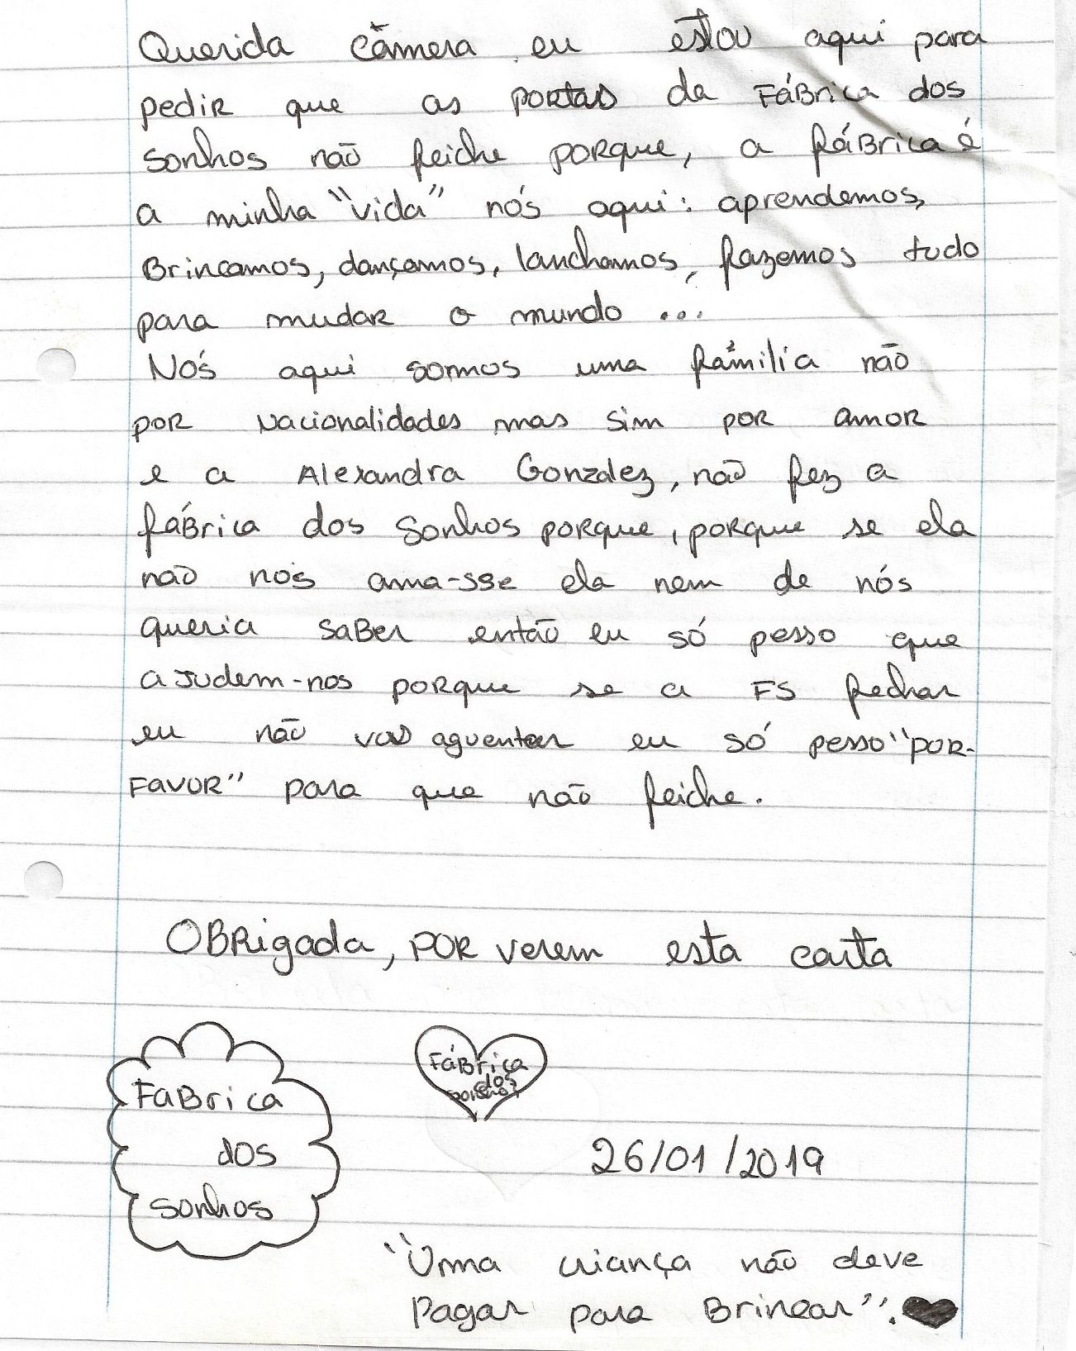
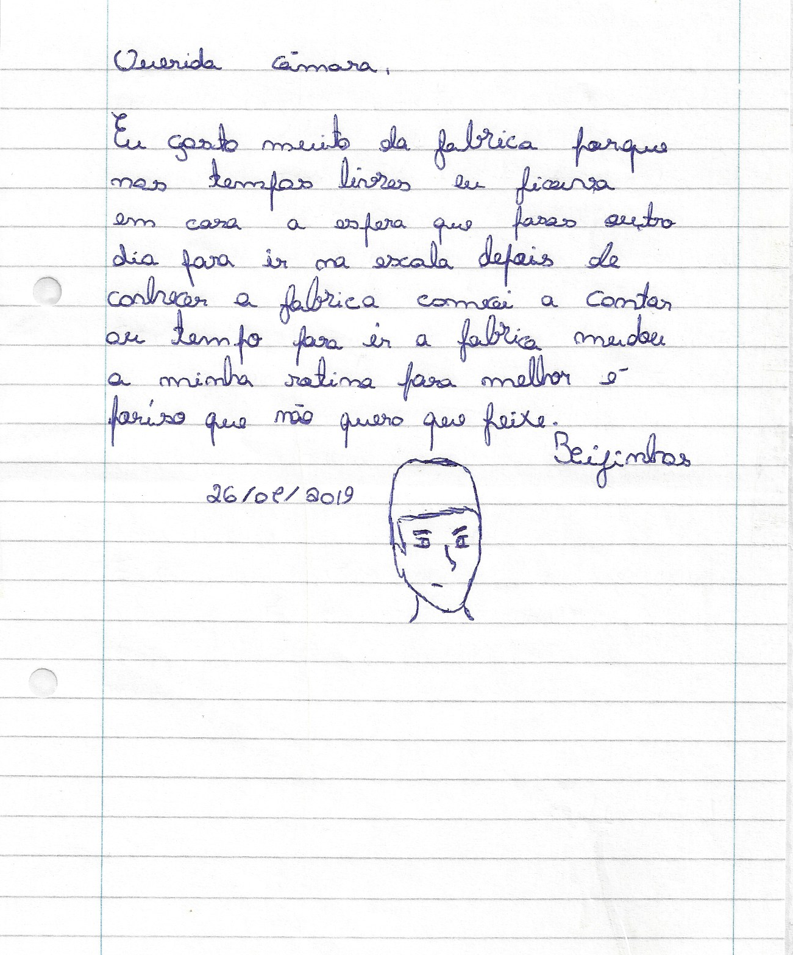

Slide 14
THE FACTORY OF DREAMS
… BY THE MEDIA’S EYES

Slide 15
RTP
TV Report
Linha da Frente: https://bit.ly/31UO6Mt
Jornal Público
19.08.2018 https://bit.ly/2Mlm9XF
28.04.2018 https://bit.ly/2LXN2Cl
07.02.2018 https://bit.ly/33aViVa
03.09.2017 - reportagem https://bit.ly/335VsNs
Diário de Noticias
https://bit.ly/2OtuvPC
Capazes:
https://bit.ly/35jZlk3
TVI
TV Show “VOCÊ na TV” https://bit.ly/2LTzEPg
TVI24 https://bit.ly/33cM22N
Rádio Comercial
23.02.2019 https://bit.ly/33fWpTl
16.07.2018 : https://bit.ly/30ZAUoF
Diogo Faro
“Sensivelmente Idiota”
https://bit.ly/2nmkDvY
Funds People
https://bit.ly/2MlgpNQ

Slide 16
THE FACTORY DREAMS
THE HUMANITARIAN VISION

Slide 17
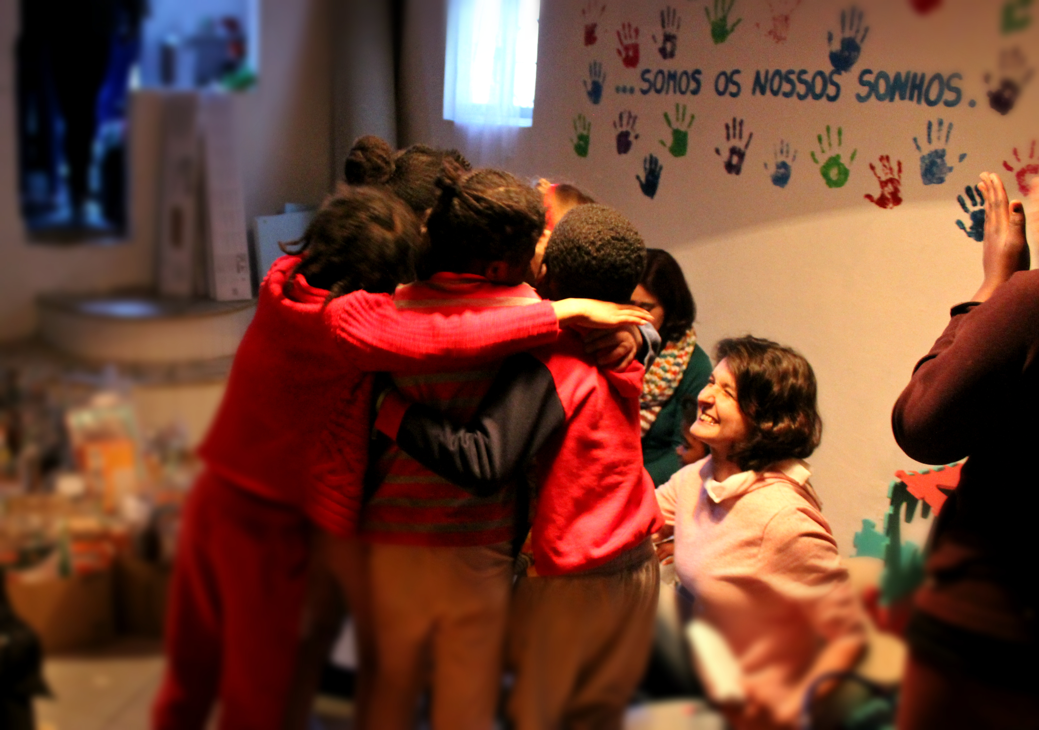
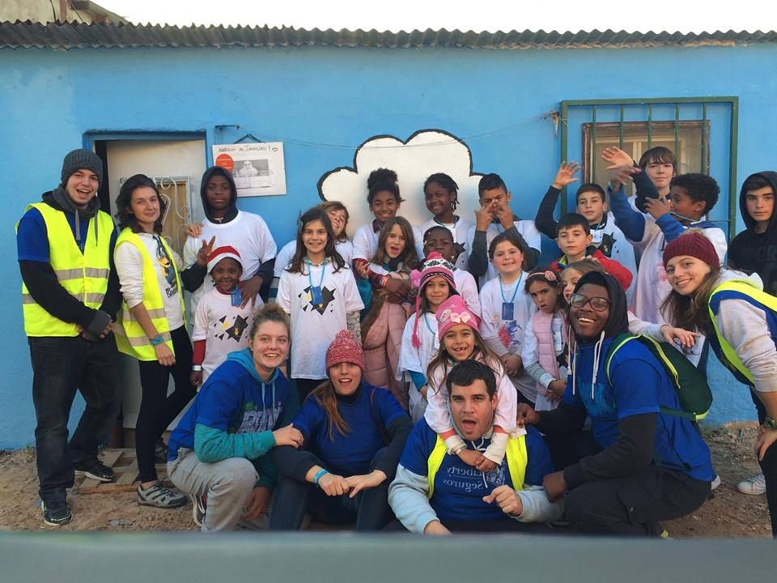
… what is the dream?
Cova do Mar Association has the vision that no child should be pay to play. We live in a society where playing is a business around the children’s happiness and the financial availability of the family unit, from the toy to the school support, karate, holiday camps or activity centers. All is a financial reason to entertain and bring happiness to the children. However, this playing access being limited (because their parents cannot provide everything), excludes the children where their family unit live at the edge of extreme poverty and/or in social exclusion contexts.

Slide 18
… how it was borned?
During a meeting with the Municipal Council of Almada, when we presented the utopia of creating the Factory of Dreams, with a rich pedagogical program and with a solidarity and humanitarian vision, it was requested us to use a tent inhabited at the 2nd Torrão neighborhood (Almada) where the previous family has been relocated.
… The Factory of Dreams became like this in a magical and enchanted place, opening its doors freely to the children between 6 to 16 years old, where they can play after school or during vacations, from Tuesday to Saturday from 3pm to 7h30pm.

Slide 19
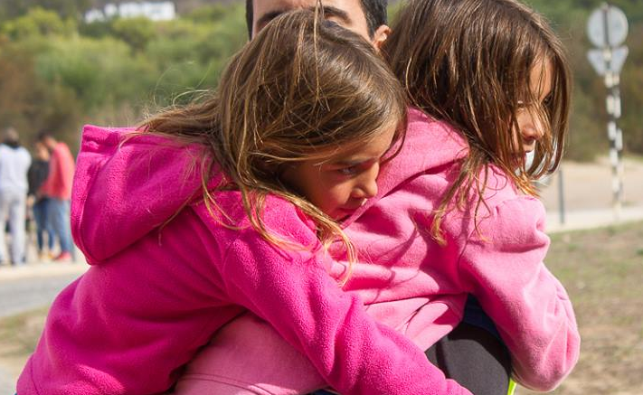
… what is our importance?
These children have a pure resilience, a SUPER POWER that allows them to face the difficulties of living in a neighborhood without legal electricity, no basic sanitation, in houses without thermic isolation. A neighborhood without the basic and decent infrastructures for the human livingness.
We know that by provide them all that they cannot access: sports, toys, technology, (tablets, computers or PlayStation) and activities outside the neighborhood; at the same time that we lend a hand and help them to find their inner balance, we’re raising future leaders more fair, conscientious and more prepared for life in humanity.

Slide 20
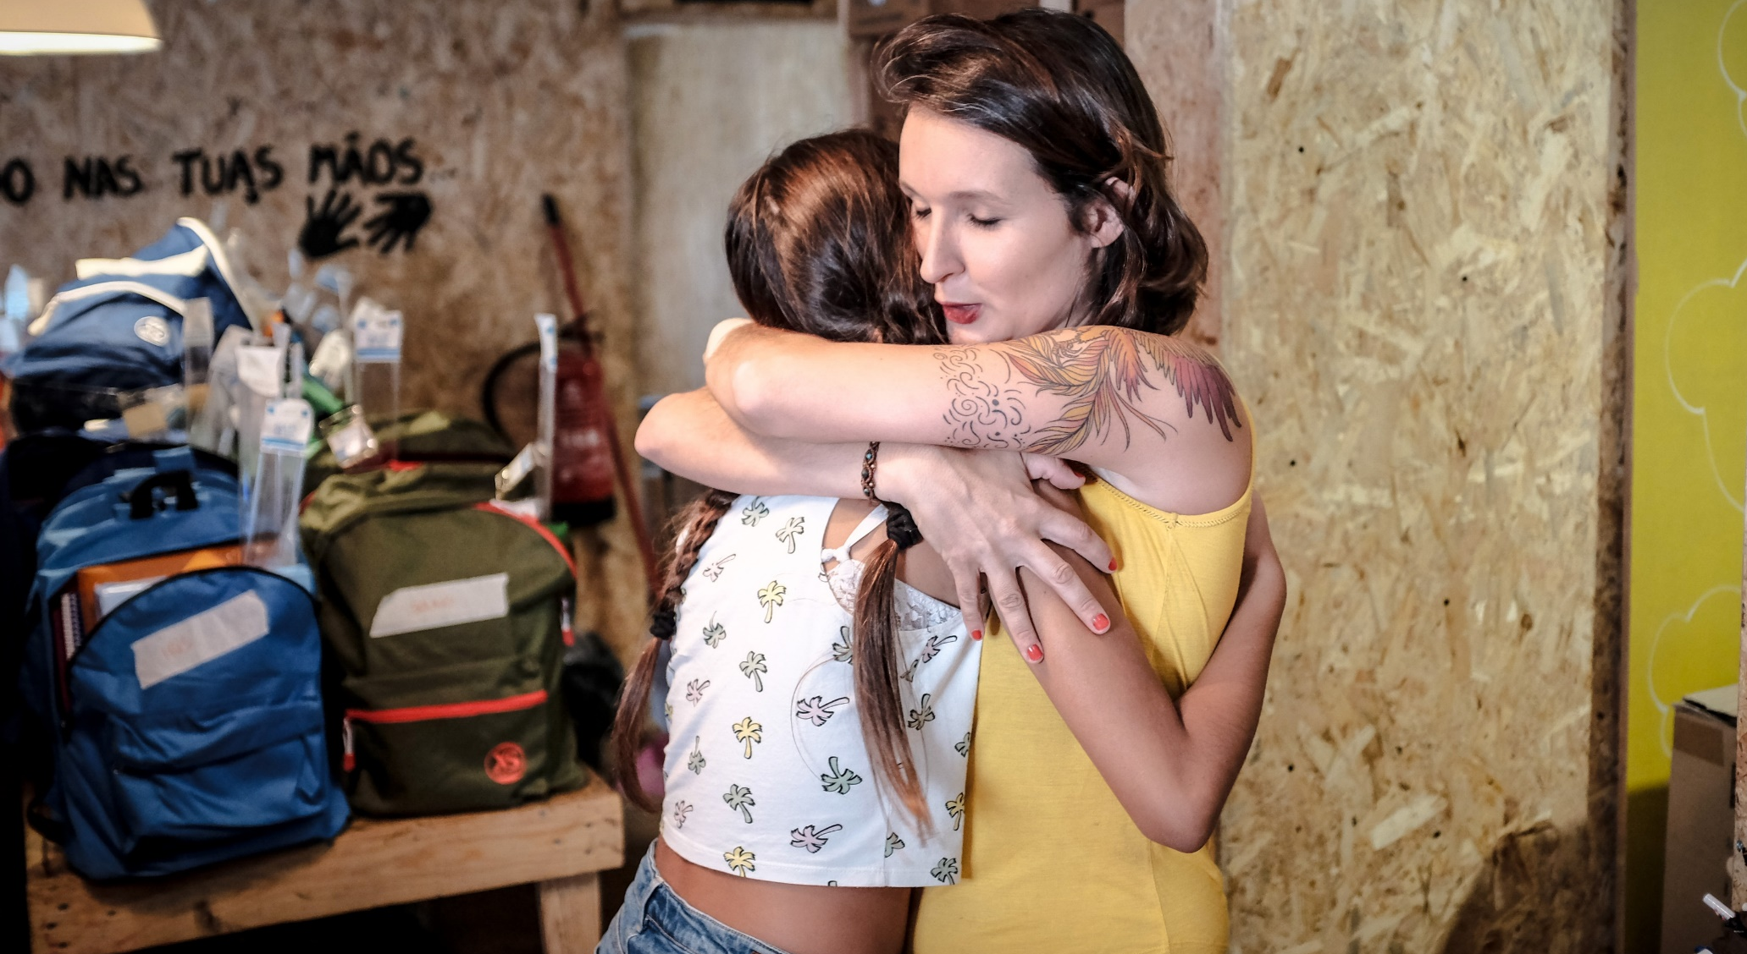
… how does it work?
We teach the children to take leading roles in the community, or in this case, inside the tribe of Factory of Dreams. For example, through the “Captain” and “Sub-Captain”, that changes daily and which functions are to be monitors on that day, taking the leading of the group and making comply the daily routine of the tribe… the tasks goes from the planning and serving the snacks, managing the toys display, managing the conflicts that may arise between colleagues, washing the snack dishes and making comply the gold rule of the Factory dreams:
“There’s no squabble (insults), there’s no physical violence, and if you do one of those you have to apologize, give a kiss and a hug.”

Slide 21
… what is the impact?
besides from the external stimuli and experiences they have access, there are other strategies of union and leadership that we do every day. We are divided by internal teams, with respective social responsibilities, like for instance:
* animals’ street team that have to feed every day the street dogs, make sure that the dog hut is clean and dry, brush the dog’s fur, give the medicines, check if they have wounds, tumors, fleas and ticks.
* clothes team take care of the clothes that arrive as donations, separate, organize and deliver to the colleagues that need them.
* school supplies team organize and do the inventory of the donations that arrive and distribute fairly for those who are in need.
(it exist also a library team, cleaning team, bikes team, PlayStation team, recycling team, toys team, cooking team and play area team)

Slide 22
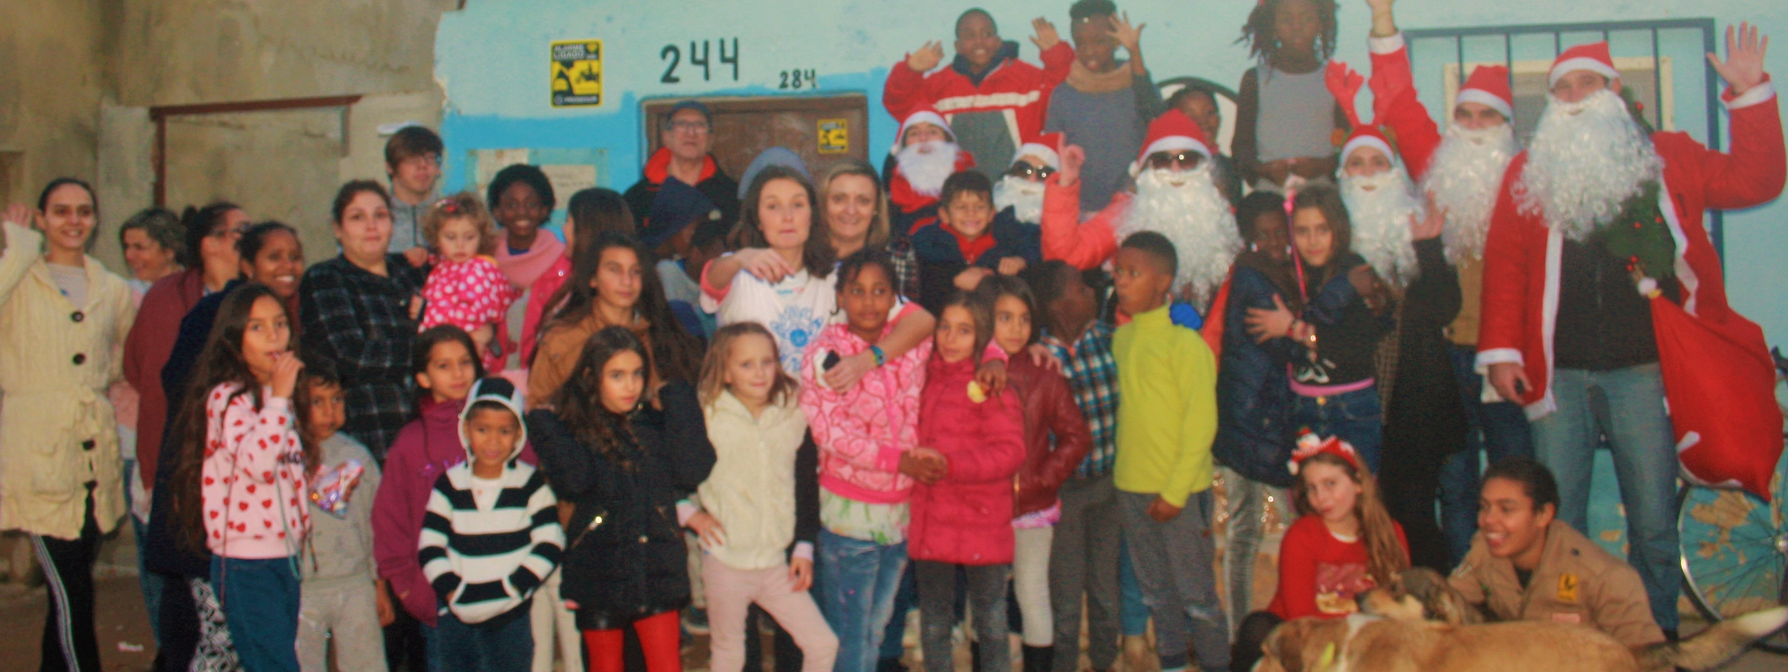
… what is our magic?
2017 CHRISTMAS MOVIE
https://vimeo.com/249771368
2018 CHRISTMAS MOVIE
https://www.facebook.com/456707061183467/videos/292266748110536/

Slide 23
THE FACTORY OF DREAMS
EDUCATIONAL PROGRAM OF THE SCHOOL YEAR 2019/2020

Slide 24
“REBENT’Á BOLHA!”
The program "Rebenta a Bolha" that has the purpose to bring opportunities and experiences to these children/young people from 6-16 years old, that allows them to pop out the isolantion bubble where they live every day. With the help of partners and volunteers, we are able to provide them freely:
KARATE
DANCE
THE INVENTORS
SCIENCE
COMMUNICATION
INFORMATICS
Biweekly classes offered by Kaizen Karaté Portugal Association and by the Sensei Zé Ramalho.
Bi weekly classes offered by Cova do Mar Association’s Monitors.
Biweekly classes offered by THE INVENTORS and its Monitors’ teams.
Biweekly classes offered by Cova do Mar Association’s Monitors.
A pack of 4 theoretical/practical classes with a final presentation of a work in the facilities of LLyC in Lisbon. This training was offered during the summer months of 2019, in order to have an impact on the return to the school year 2019/2020.
Monthly classes offered by Cova do Mar Association’s Monitors.

Slide 25
“TAKE CARE OF OTHERS!”
Beyond the stimuli and experiences that they have access, there are also another union and leadership strategies that we do every day. To guarantee that we are raising the next humanitarian leaders, we built the program “Take Care of Others” were we are divided by internal teams, with specific social responsibilities:
RECYCLING
PLAYSTATION
BIKES
LIBRARY
COOKING
Its purpose is to take the trash that the colleagues separated at the Factory, until the nearest recycle bin.
They have to assure that everyone respect the rules and the games’ time.
With the help and supervision of the Almada’s Cicloficina and Anjo’s Cicloficina, they have to help the colleagues to fix their bikes and do the triage of those who need a new bike.
Managing and organizing the library, put in the right place and catalogue the books, managing the borrowed books, managing the access and the children’s usage of laptops and printer.
From time to time they have to cook cool stuff for the group, like pancakes, waffles, cakes, ice creams, etc.
TOYS AND GAMES
CLOTHES
SCHOOL SUPPLIES
ANIMALS
PLAY AREA
CLEANING
They have to organize and manage the games, and check if they are ruined or if something is missing.
Take care of the clothes that arrive as donations, separate, organize and deliver to the colleagues in need.
Organize and do the inventory from the arriving donations and distribute fairly for those who need.
They have to feed every day the street dogs, to guarantee that the dog hut is clean and dry, brush their fur, give the medicines, check if they have wounds, tumors, fleas and ticks.
Managing the good usage of the ping-pong table, darts game and bow and arrow game.
Everyone arrange things at the Factory, but this team has to manage if there is toilet paper/ paper towels stock, if there’s the need to manage the closets, if the general arrangements are working well, if the bins have trash bags, etc.

Slide 26
WHO ALREADY HELPED TO CHANGE
OUR WORLD?

